Slide 1

OneQuesh:
How To Find Good Questions?
Team B3
Luke Hong, Ann Lu, Caroline Guo, Mona Ma, Hanyu Chen

Slide 2
Table of Contents
Problem Statement
Key Findings & EDA
How to find a ‘good’ question
How to relate popularity with marketing activities
Summary & Limitations
Next Steps

Slide 3
Problem Statement
The goal of our business analysis is to help OneQuesh increase user engagement by analyzing and creating effective questions and identifying marketing activities that could attract more new users.

Slide 4

What makes a ‘good’ question?
Hypothesis 1:
Quantitative
Higher responses per user
Higher average character count
More positive responses than negative
Higher average rated questions
Qualitative
Thought provoking
Fosters real human interaction
Probing
Non-triggering wording

Slide 5
Key Findings & EDA
Part a. How to Find Good Questions?
Data Perspective
Sentiment Analysis
Character Count
Question Clustering Based on Features

Slide 6
Sentiment analysis is enabled by algorithms that assess the tone of a transcript on a spectrum of positive to negative, and is used to understand the emotion behind verbatim comments from open-ended questionnaires.
Sentiment Analysis
Character Counts
Using the average character length of a question or response, we explored if there is a higher response rate.

Slide 7
Sentiment Score Top 10
Sentiment Score Bottom 10
Questions | Avg Score on Responses
What company inspires you most? | 6
Who has been your best teacher and why? | 5.94
How has November been for you so far? | 5.11
What has been the highlight of your week? | 4.38
What was the highlight of your weekend? | 4.21
Questions | Avg Score on Responses
What do you need to leave behind this year? | -1
What’s the scariest movie you’ve seen? | -0.5
Which movie is the most quotable? | -0.375
If you could know the truth behind any one secret or mystery, what would it be? | -0.2
What song have you listened to most this year? | -0.2

Slide 8
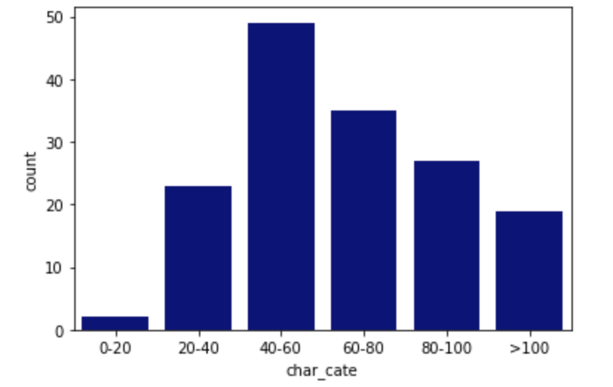
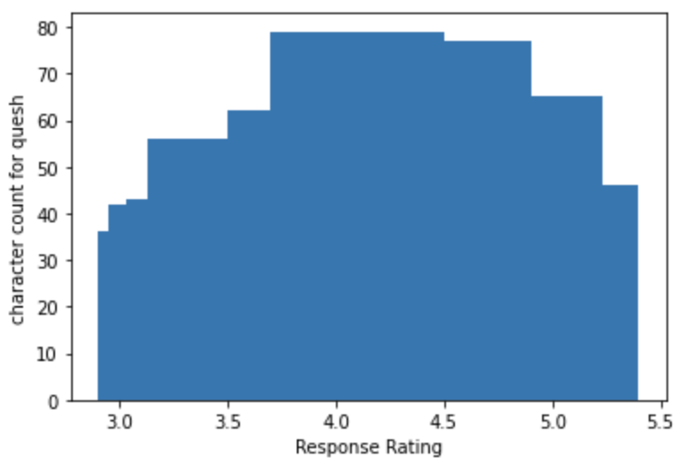
Character Counts
The Relationship between Response Rating and Character Counts
Most of the questions have around 70-80 characters and have a response rating of 4.0 to 4.5
Average Character Counts of Responses for Each Question
Most of them are around 40-60

Slide 9
Clustering - Segment the questions into groups based on their key features
The data we deal with has the following features:
Average rating
Total response
Sentiment score of answers
Sentiment score of quesh
Character count
 | Average rating | Total response | Sentiment score of answers | Sentiment score of questions | Character count
1 | 4.75 | 8 | 4.375 | 0.0 | 94.875
2 | 3.86 | 22 | 2.045 | 5.0 | 76.227
3 | 3.94 | 17 | 1.647 | 7.0 | 53.941
We want to segment those questions into groups so that we can clearly see which group is the ‘best’ group with higher rating, response etc.

Slide 10
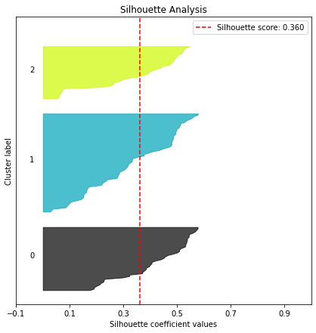
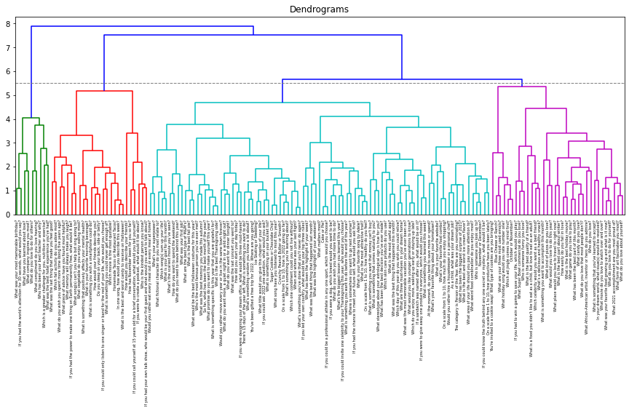
Clustering 1 - K-Means
Clustering 2 - HCluster
4 Clusters
Group of cases (observations/rows) based on similarities in input values
See the clusters clearly
3 Clusters
Cluster results do not fit our business problem as well as h-clustering

Slide 11
Hypothesis 2 - Profile questions into groups to find common traits of ‘good’ questions - HCluster
Cluster | Average rating | Total response | Sentiment score of answers | Sentiment score of questions | Character count
1 | 4.31 | 15.11 | 5.37 | 2.44 | 139.53
2 | 4.60 | 8.28 | 1.75 | 0.84 | 58.83
3 | 4.01 | 15.84 | 1.49 | 0.93 | 63.38
4 | 3.98 | 21.21 | 2.01 | 3.06 | 67.19
Cluster 1: Second highest rating, second total response, highest sentiment score and character count.
We want to generate questions like ones in this group the most.
Example:
What was your most memorable birthday?
If you had the world’s attention for 10 seconds, what would you say?
Notes:
Higher rating: There are not too much people done the rating. One person’s decision can affect everybody else’s.

Slide 12
Key Findings & EDA
Part b. How to Relate Popularity With
Marketing Activities?
User’s Perspective

Slide 13
Part b : Users Data Analysis
Data: contains information on multiple users
6 columns includes: User status, join-in date, date of birth, whether the profile is complete, and whether the users are active or not
Analysis Focusing on :
New sign-ups data distribution - finding the relationship with the frequency of marketing activities
Age distribution- finding the target users age group.

Slide 14
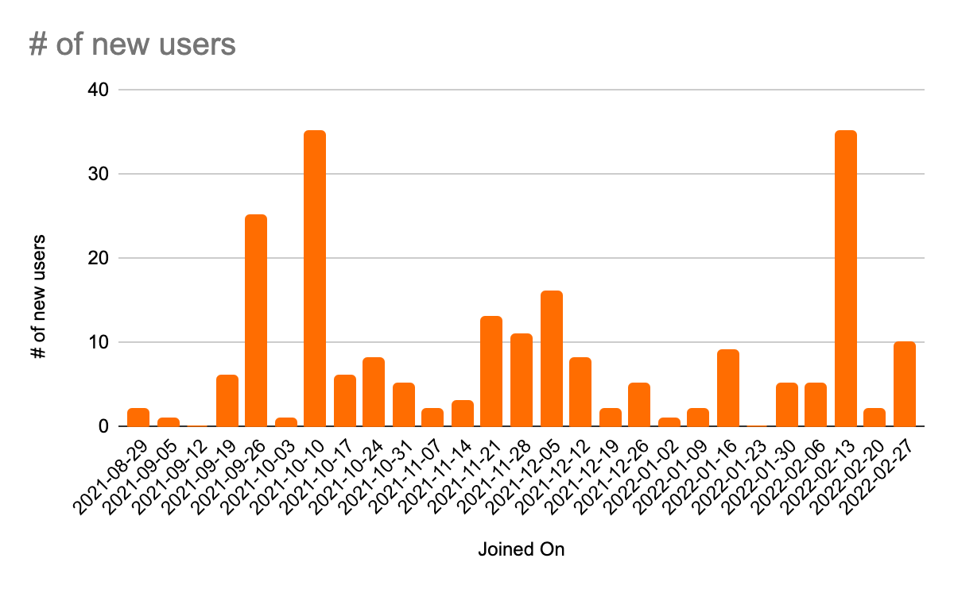
Hypothesis 3 - We assume that that marketing activities will coincide with more new users joining the app than usual.
The spikes appeared in the end of September, early of October, and the mid of February
Networking is the main marketing activity include in-person networking events, social media collaboration, and different types of virtual events.
Networking during this time of period is highly effective

Slide 15
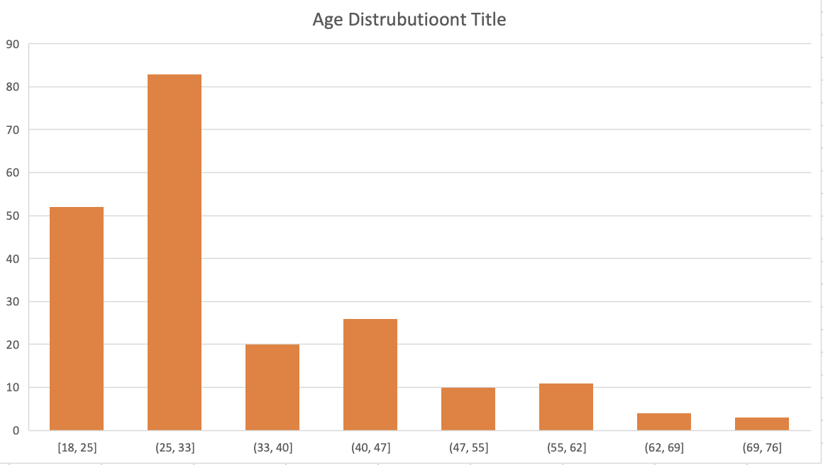
Hypothesis 4 - We assume the majority of the users are in the 20-30 year old age group
Finding:
61% of users are between the ages of 18 and 33
21% of users are between 33-47
Next step:
Target these age groups and tailor questions to them
Focusing on networking with these age groups
Age Group Distribution
61%
21%

Slide 16
Summary
Features and Clustering Analysis
Sentiment Score: Gives a score to quantify the emotional tone of each Quesh and response.
Character Counts: Count the characters for each Quesh and response. A popular question tends to have a higher character count.
Clustering: Segment the questions into groups based on their key features, and our best model is H-cluster with 4 clusters, and our cluster 1 has the best performance.
Predictive Model: NLP, KNN,and BERT models for prediction. 100 created questions used to test the models. 91% accuracy in predicting the type of questions and predicted that the average rating of the 100 questions has a mean of 4.38.

Slide 17
Summary
User Data Analysis
Join-in data distribution: Networking is important way of gaining new users
Age Distribution: Until now, most of the users are in the age group of 18-33 and 33-47 years old.

Slide 18
Limitation & Challenge
Predictive Model: Limitation in data challenged us to build an effective predictive model to predict if a question has a higher popularity.
Question Bank: Due to the privacy of the un-published questions, we used 100 question that created to test the performance of the analysis. If more questions to train are given, we can get a more practical results.

Slide 19
Next Steps
Create an algorithmic model to predict “will-be” popular questions by getting more data.
Add more features to evaluate the performance of questions:
e.g. gather information of user’s mood based on emojis.
Add age factor in our analysis and see if tailoring questions to different age groups would affect the response rate.

Slide 20

Questions?

